Slide 1
CENTER FOR HOLISTIC EDUCATION
A unit of Missional Yatra India Charitable & Educational Trust (MY INDIA) registered at Nagpur
Affiliated with Indian Institute of Missiology, an affiliate agency approved by ATA and IMA
Executive Director & Principal: Rev. (Dr.) Hruda Ranjan Lohora
Academic Advisors: Dr. Anuj Patro, Bishop Paul Dupare, & Dr. J. Ganesapandy
Registrar (Honorary): Rev. Diwakar Londhe

Slide 2
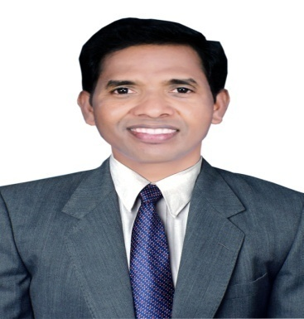
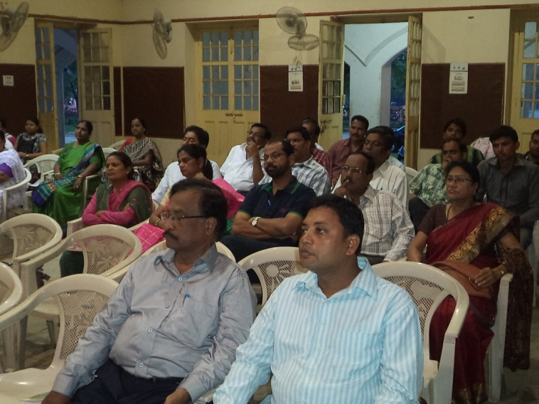
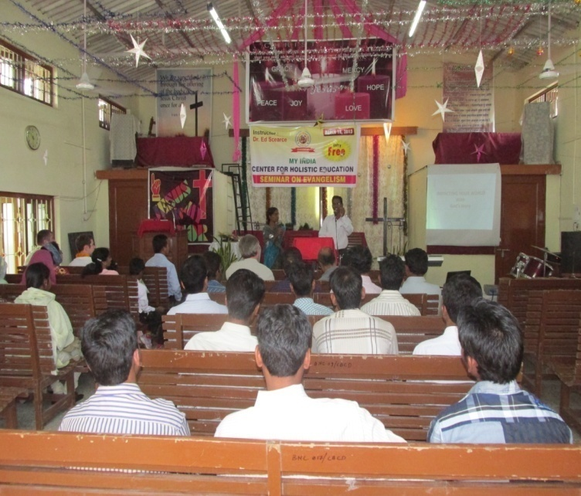
VISION
Hruda Ranjan Lohora
Envisioned to train missiologically Every Christian of every Church in
Indian cities to be mission-oriented akin to the Apostolic Church, and thereby, fulfill the Great Commission of Jesus Christ developing mission oriented Christians to be witnessing glocally in the whole world by the whole Church with the whole Gospel.

Slide 3
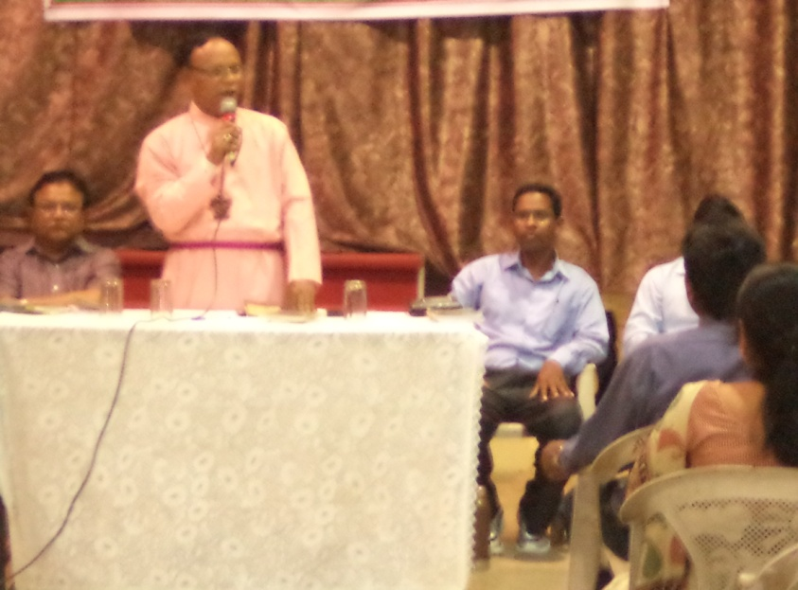
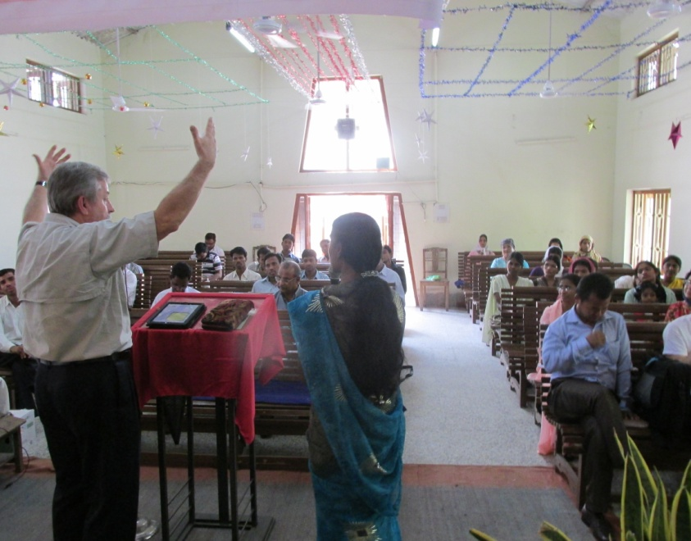
MISSION
Committed to equip the Christians with biblico-centric theological and missiological education, and the urban pastors with Transformational Urban Leadership through multi-campus based non-residential training programs incorporated with contact classes, seminars, and extra curricula activities with an ultimate aim to make out entire Christians’ participation in God’s Mission to transform the society spiritually, socially, economically, and politically.

Slide 4
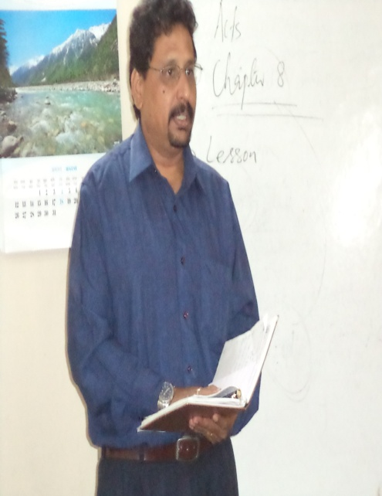
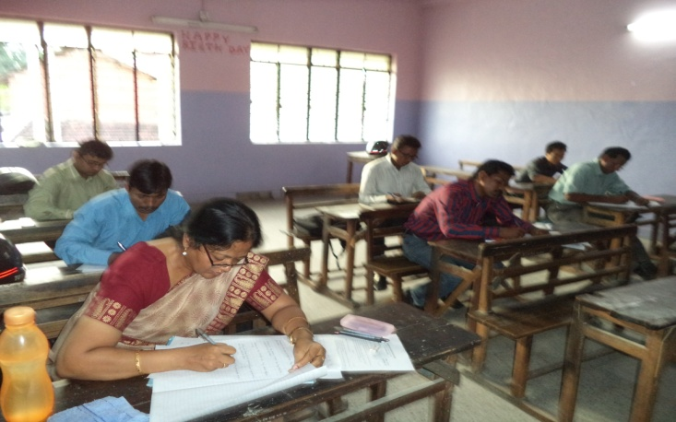
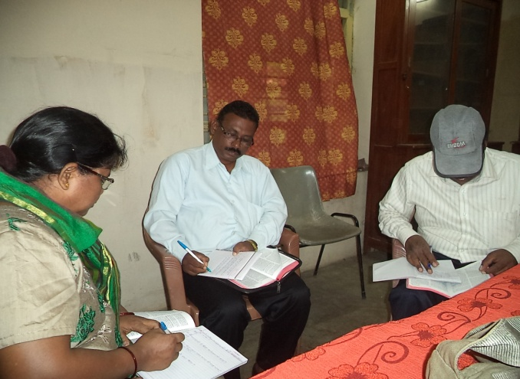
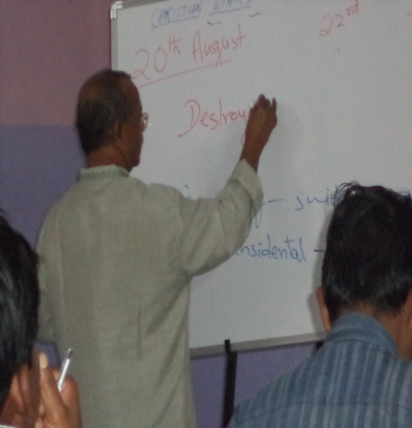
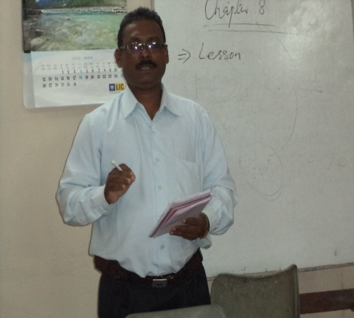
CORE VALUES
Foundational
Glorifies God above All Else
Highest Honor to God's Word
Enthusiastic Devotion to Prayer
Selflessness Commitment to God
Spirit Controlled Life and Service
Functional
Honesty
Harmony
Team Work
Servant Leadership
Goal Oriented
Methodological
Building Inter-Personal Relationship
Respecting all humanity with humility
Prioritizing the Marginalized in the Community
Worldview Based Missiological Training
Missional Church Multiplication

Slide 5
Transformational Urban Mission
1. This program aims to train leaders who has evidence potential to catalyze or strengthen redemptive movements, through church-planting, transformational development, economic discipleship, coalition-building, and creative problem-solving.
2. Students' leadership, character and managerial capacities are developed through mentoring under educators and experienced church-planters, business people, and spiritual mentors.
3. Theoretical study is integrated with experience-based learning so that students don’t merely learn about urban poor realities, but are directly engaged with urban communities through each of their courses. Most courses follow an action-reflection model.
4. Adult education approaches to learning, students build theology from the stories of the poor, as these engage the stories of the scriptures, and academic literature, resulting in transformational conversations. The locus of the power of knowledge is sustained as the knowledge of those among the poor, but from this vantage they also critically engage the literature of the academe, a reading of the scriptures from the underside of history, and the elites who reflect on how to change the poor and poverty aided by social analysis.
5. Rather than being sequestered in an academic compound, students learn to enter the pain and problems of the urban poor, in identification with them in their experiences of suffering and oppression, bringing the hope of Christ

Slide 6
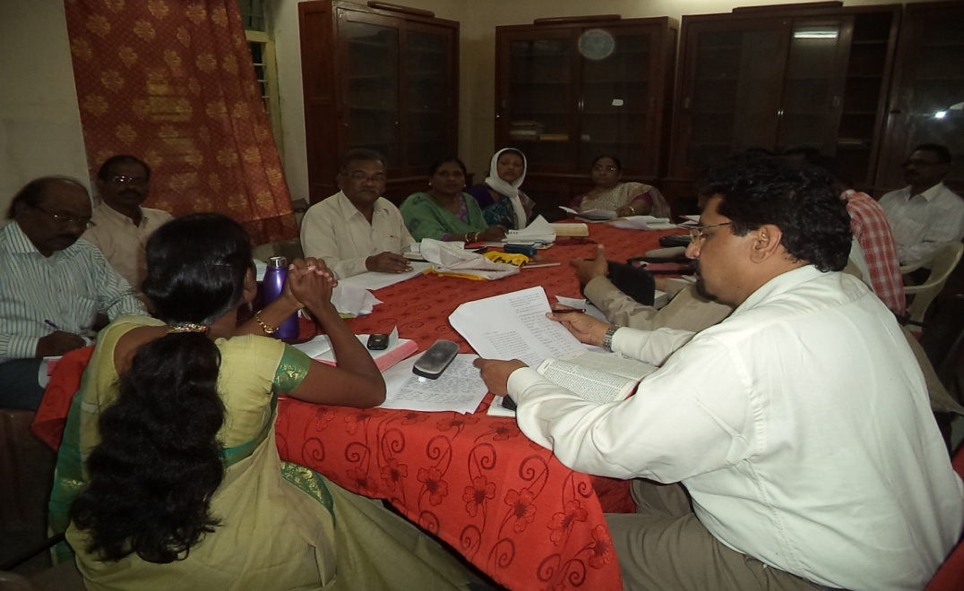
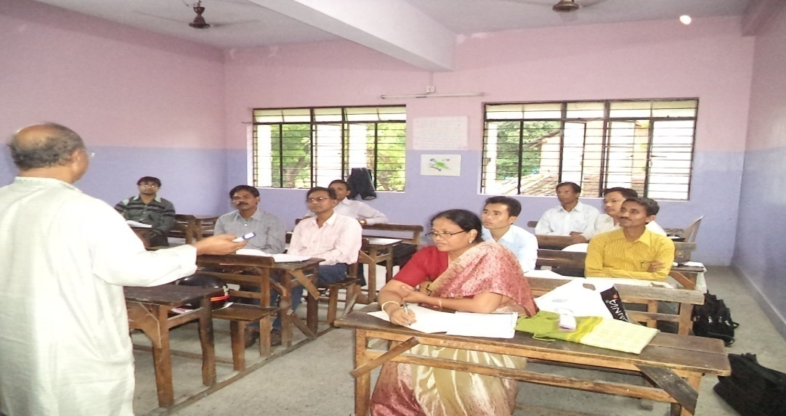
Mode of Operation
Modular Mode:
- Classes are conducted 4-5 days in a month. More filed works
Distance Mode:
Contact Classes are arranged twice in a year.
Each contact class goes for a week of eight hours everyday.

Slide 7
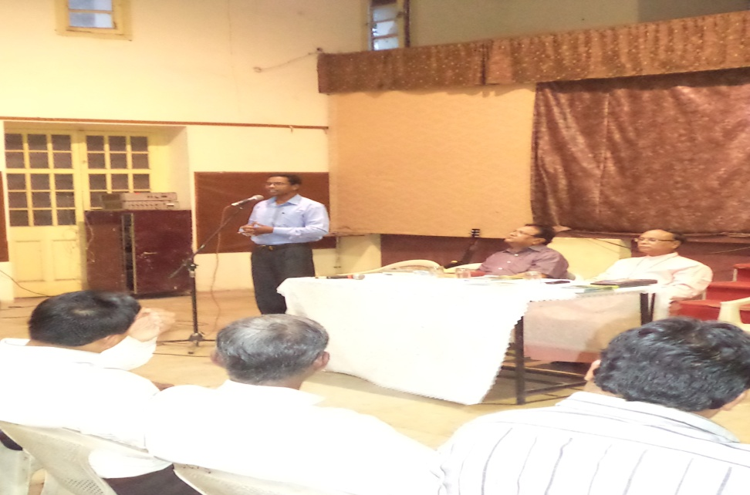
Target Community
Christians who are not able to go to a Bible College owing to various reasons.
Eg. Professionals, Employees, Pastors, Evangelists, housewives, School-going youths, etc.

Slide 8
CURRICULUM
Holistic: Knowledge, Character, and Skill
The core courses of Asia Theological Association
The Senate Courses of Indian Institute of Missiology
The core courses of Urban Leadership Foundation, Encarnacao Alliance Training Commission

Slide 9
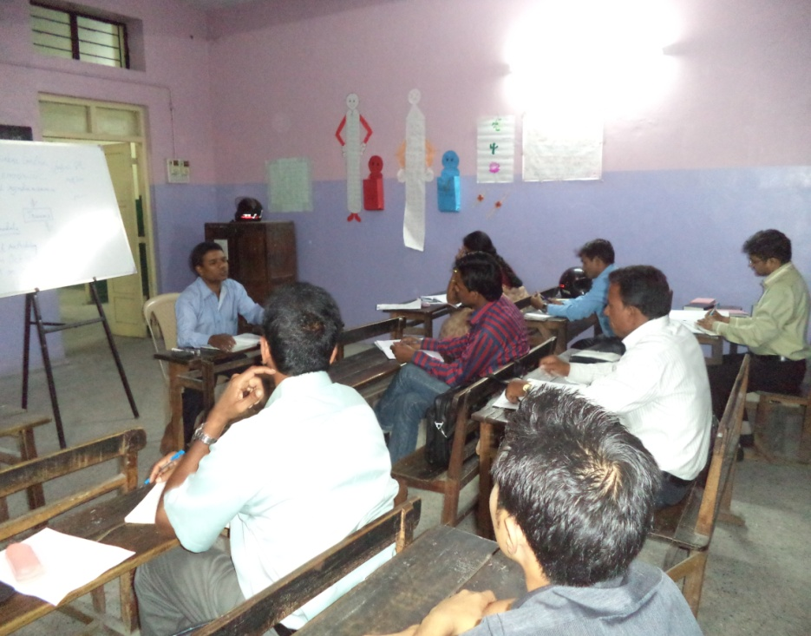
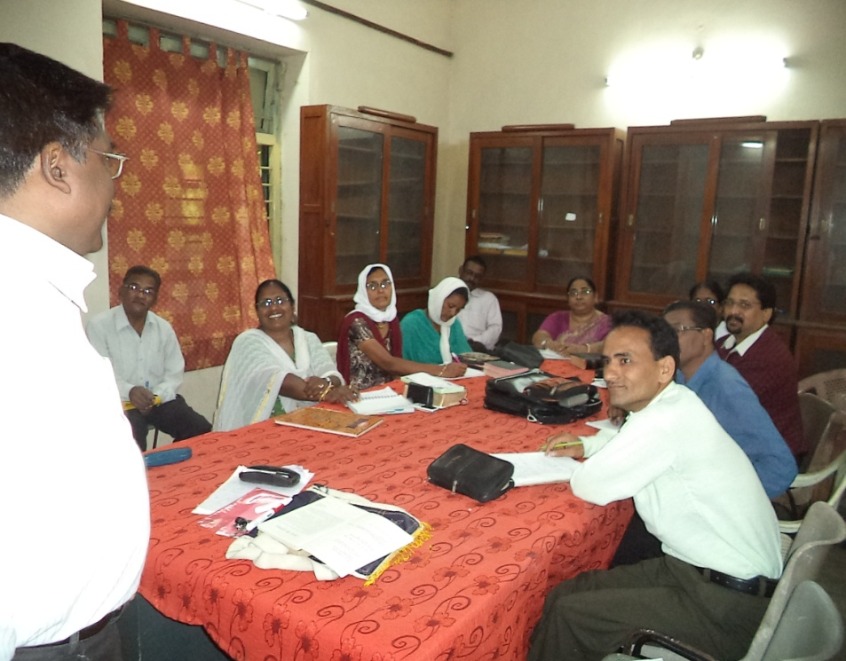
Class Procedure
Modular Mode: Mostly on Saturdays or in the evenings of any day in a week as per the availability of the community
Distance Mode: Mostly during Summer Vacation & Diwali Vacation. Yet, there is an adjustment as per the availability of the students

Slide 10
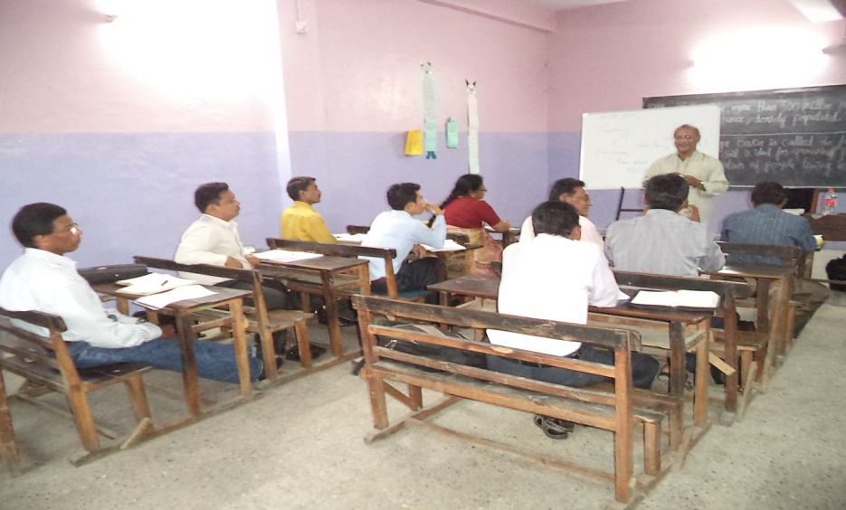
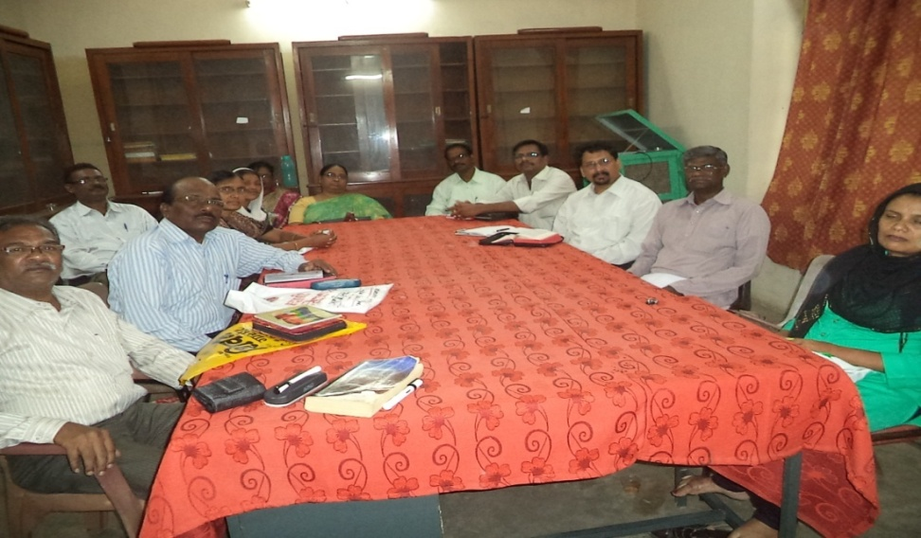
Programs Offered
Certificate Program : 12 Courses/1 year
Diploma in Theology: 24 Courses/2 Years
Bachelor of Theology: 36 Courses/3 years
Master of Divinity : 24-36 Courses/2-3 Years
Transformational Urban Mission: 14 Courses/2 Years

Slide 11
Course Methodology
Programs | Lectures | Paper Presentation | Class Discussion | Field Research | Library Research
B.Th. (12x3=36) | 16 hrs | 10 | 10 | 20 | 16
M.Div. (15x3=45) | 20 hrs | 15 | 10 | 25 | 20
Internship for B.Th . & M.Div. | Two months of internship every year. One month for each internship course

Slide 12
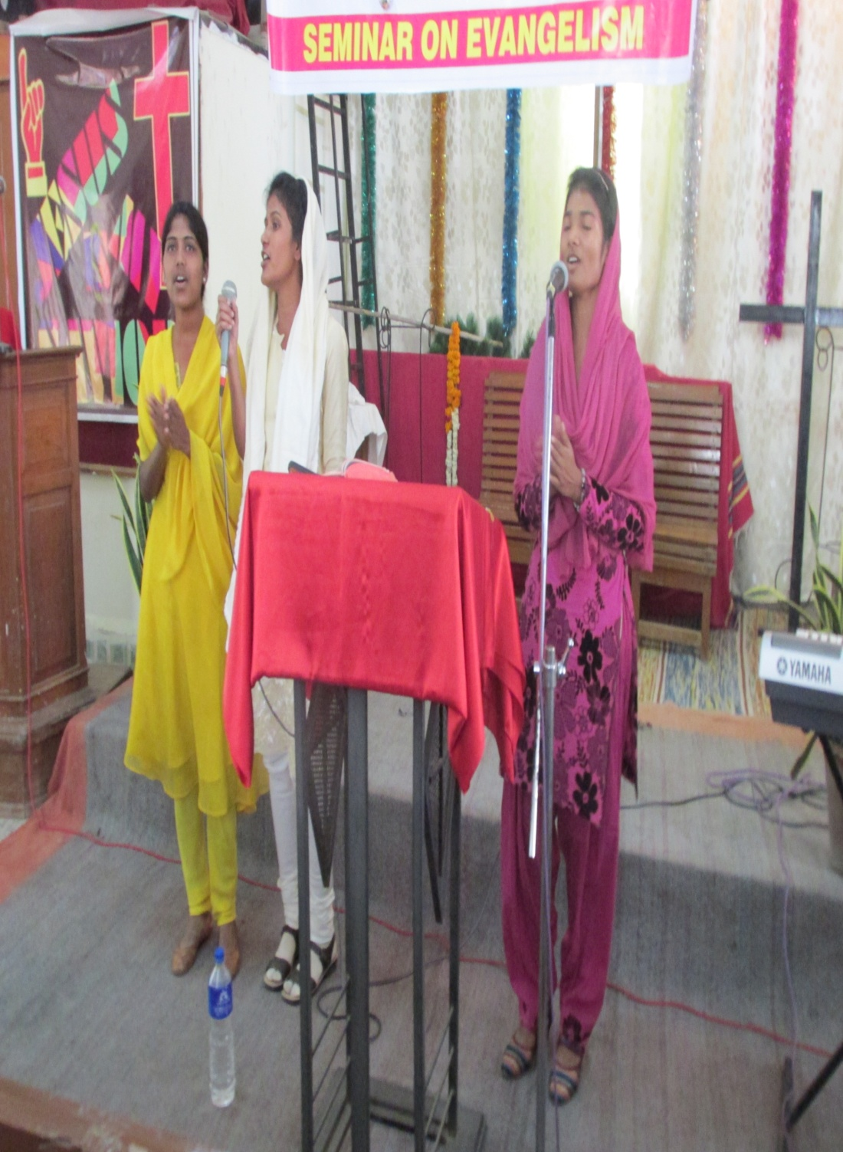
Students’ Activities

Slide 13
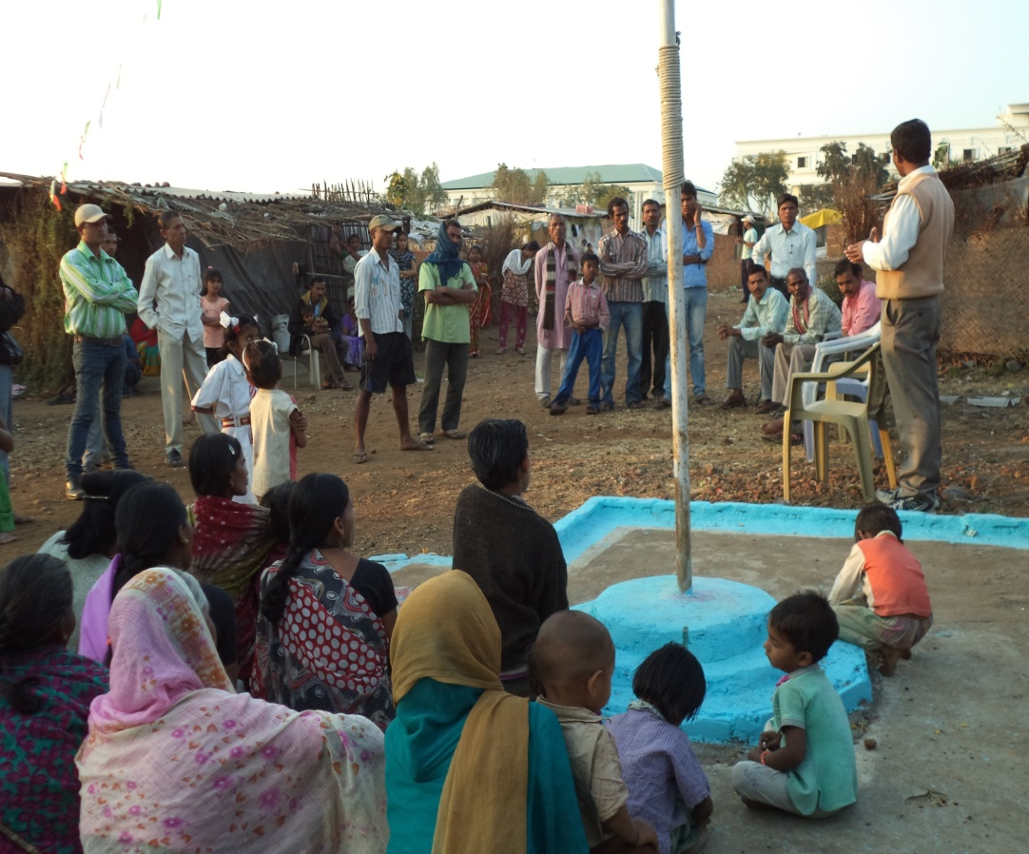
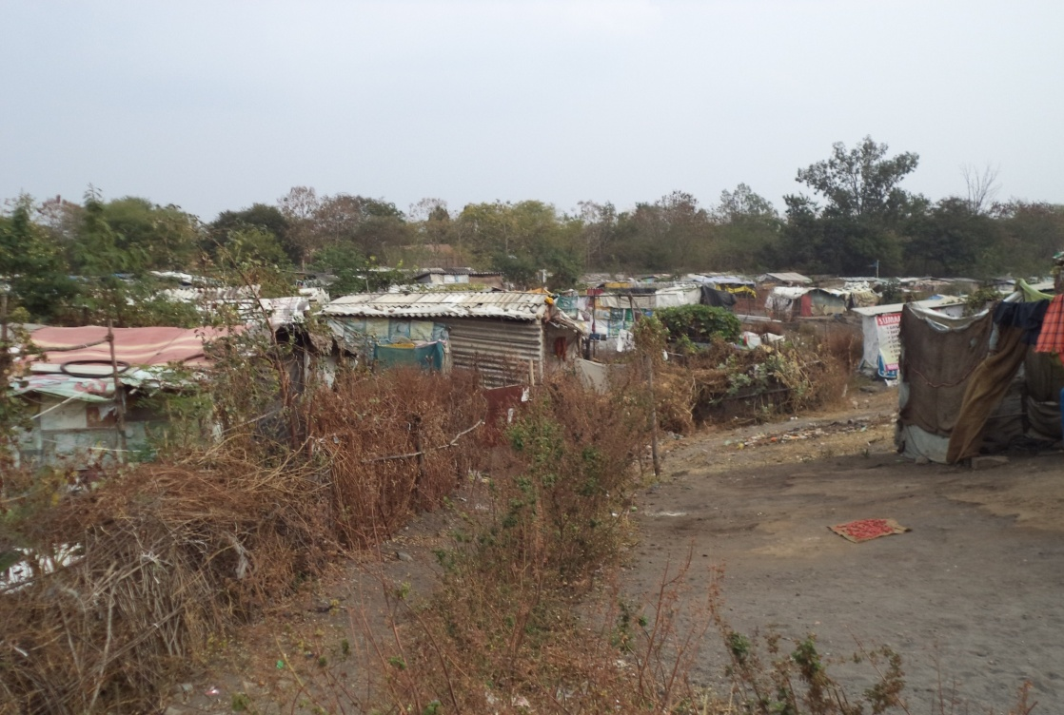
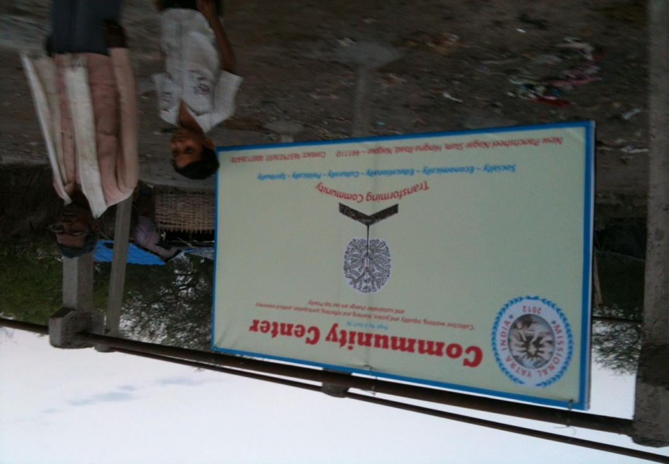
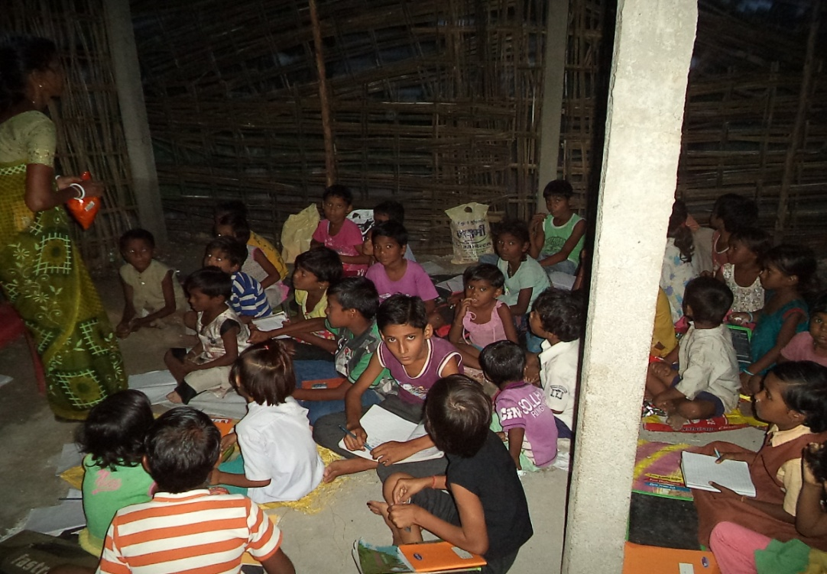
MATUL IN PRAXIS
New Punchsheel Nagar Slum, Nagpur

Slide 14
Entrance Requirements
Certificate Program: Know Reading and Writing
Diploma Program: 10th Pass
Bachelor Program: 12th Pass
Master Program: Any Graduate

Slide 15
Faculty
Faculties are inducted from the Churches and Seminaries, who have possessed with ATA/SSC degrees.
Faculties teaching up to Bachelor level of programs must have a BD or M.Div.
Faculties teaching to Master of Divinity must have a M.Th. or a Doctorate

Slide 16
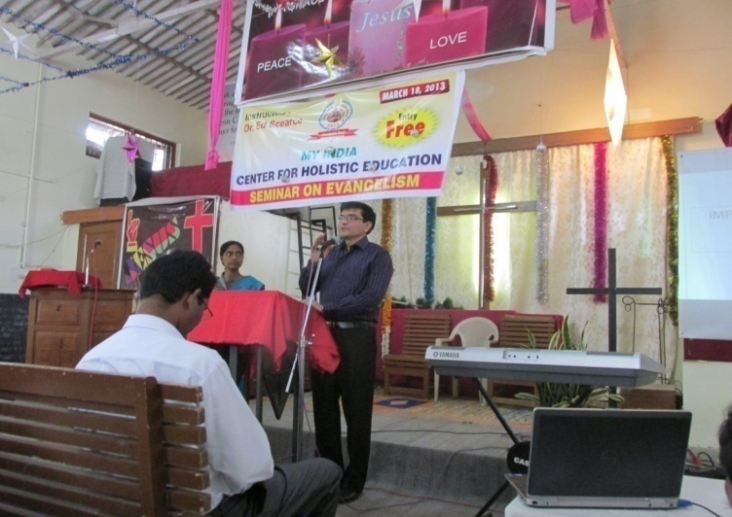
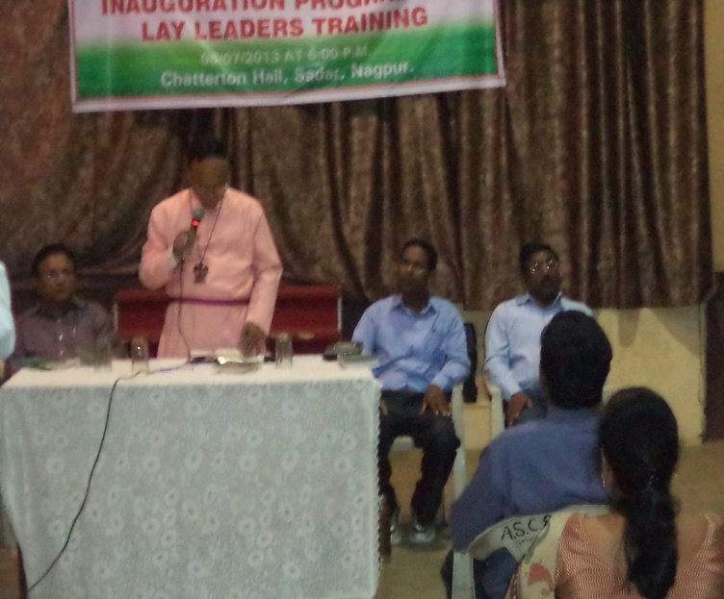
On Going Programs
Master of Divinity Program in partnership with Life Christian University (India)- Rev. John Joseph.
Venue: Bishop Cotton Primary School
Diploma & Bachelor Programs in partnership with Nagpur Diocesan Council (CNI)- Bishop Paul Dupare.
Venue: Cathedral Compound (Mahila Saddan)

Slide 17
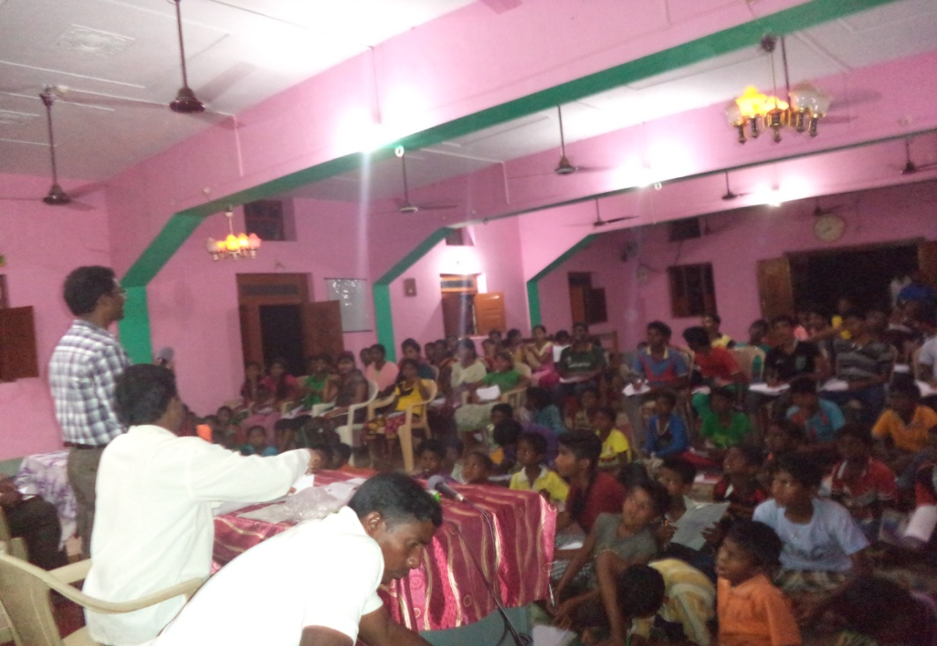
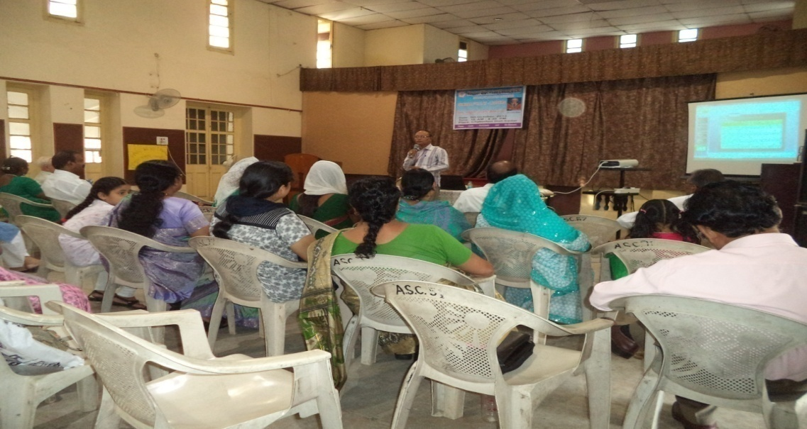
Seminar Based Training
Mission & Evangelism
Community Transformation &
Church Growth
Kingdom Concerns

Slide 18
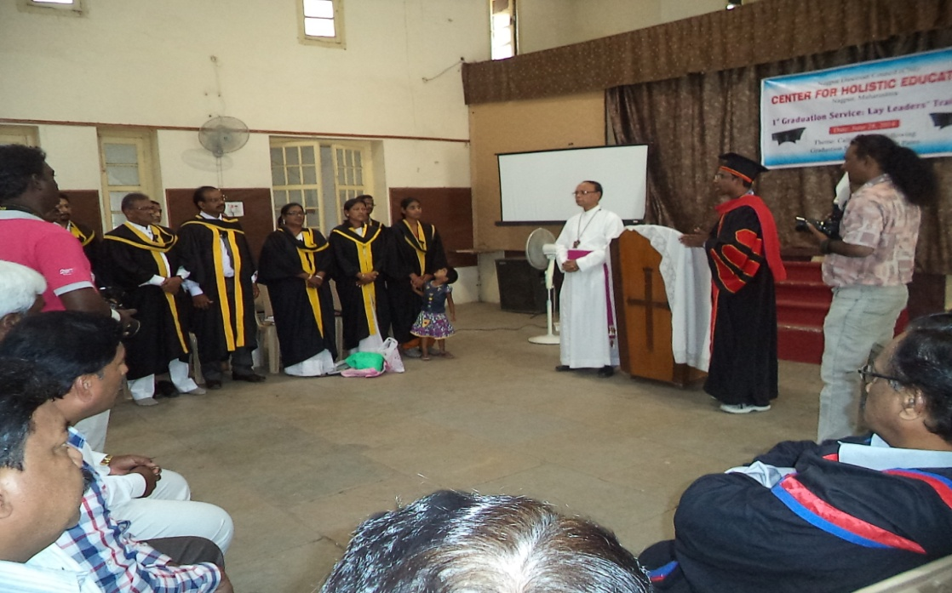
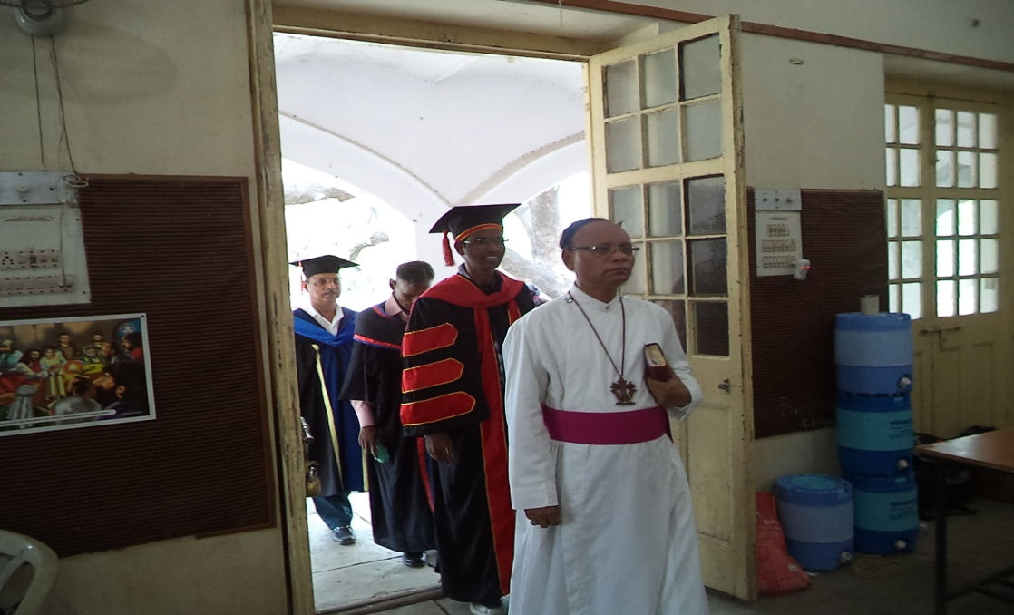
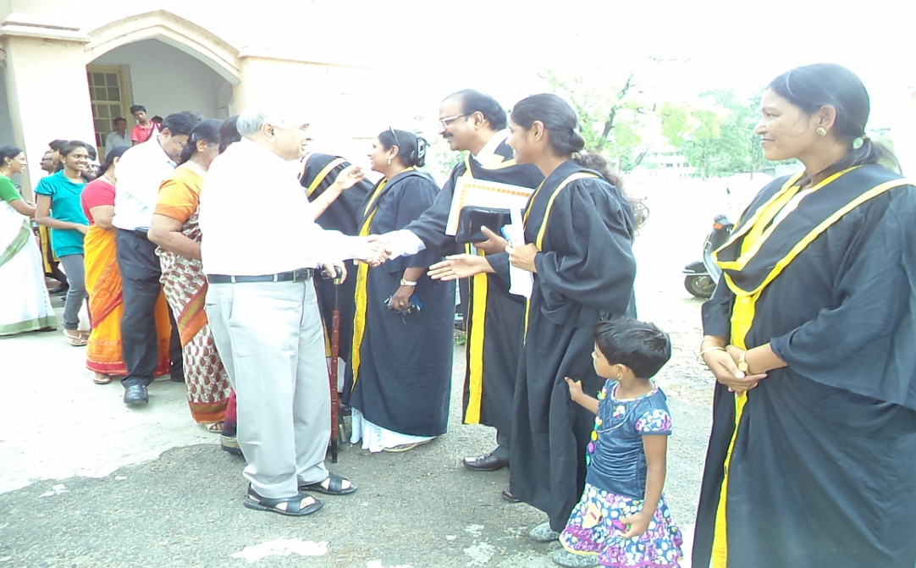
CHE Graduation 2014

Slide 19
Prayer Points
Vision to promote everywhere in India
Need an Office of its own
Need a Library with 5000 volumes of books
Need a Common Training Hall
Need a Light Vehicle for Multi-purpose
Need a Faculty Lounge
Need $ 300 every month for a center to extend its program to different parts of India

Slide 20
Budget for a Preschool
S.No. |  | Particular | Minimum required | Minimum support/required | Minimum Fund for one month | Minimum Fund for one year | Minimum Fund for five years
FUNCTIONAL NEEDS
1 | Teachers |  | 04 | $ 50/teacher | $ 200 | $ 2400 | $ 12000
2 | Staff |  | 02 | $ 50/staff | $ 100 | $ 1200 | $ 6000
3 | Headmaster/Headmistress |  | 01 | $ 150 | $150 | $ 1800 | $ 9000
4 | Travel Expenses for Administrative staff |  | - | - | $ 100 | $ 1000 | $ 5000
5 | First Aid medicines |  | - | - | $ 100 | $ 1000 | $ 5000
6 | Classroom rent |  | - | - | $ 150 | $ 1800 | $ 9000
MATERIAL NEEDS
1 | School Books |  | 50 sets | $50/set | - | $ 2500 | $ 12500
2 | Note Books |  | 50 Sets | $10/set | - | $ 500 | $ 6000
3 | Pencil (2 Nos each) |  | 50 sets | $ 0.25/set | $ 13 | $ 130 | $ 680
4 | Color Pencil |  | 50 sets | $ 0.50/Set | $ 25 | $ 250 | $ 1250
5 | Uniform (Two colored) |  | 50x2 sets | $ 10/set |  | $ 1000 | $ 5000
 | TOTAL REGULAR NEEDS |  |  |  | $ 838 | $ 13580 | $ 67900
 | ONE TIME NEEDS
1 | Children Outdoor Amusement park |  | 1 set |  | $ 5000
2 | School Van |  | 1 |  | $ 15000
3 | Shelf |  | 1 |  | $ 120
4 | Table & chair |  | 2 set |  | $ 50
 | TOTAL ONE TIME NEEDS |  |  |  | $ 20170

Slide 21
Contact
Rev. (Dr.) Hruda Ranjan Lohora
Founder/Executive Director
CENTER FOR HOLISTIC EDUCATION
Post Box-27, 59-Dhyaneswar Layout
c/o Community Baptist Church
Wadi/Dattawadi-440023
Amaravati Road, Nagpur (MS)
Cell Phone: 9657923697/9890754967
E-mail: hrudarlohora@india.com/lhranjan@gmail.com
Website: www.myindiamission.in

